Slide 1

Hedge Fund Accounting
Automating Private Equity Cash Reconciliation Process

Slide 2
Overview
Objective
To develop a robust and scalable Cash Reconciliation solution for Private Equity Clients that leverages AI capabilities to automate and enhance the accuracy of Cash Reconciliation activities and generate comprehensive reports.
How it works
This AI Powered tool built on top of our Compass platform combines our existing capabilities (Web crawling/Excel automation) to
Extract reports from Bank websites
Extract reports from accounting system
Reconcile and Generate activities for reconciliation
Add missing entries to accounting system
Update mismatching entries in accounting system
Report Generation

Slide 3






Current Process
Offshore Analyst
Start
All Check Points Clear?
Validate Reconciliation using 3 Check Points
No
Login Investran
Download Activity, Balances and Transaction Details Reports
Yes
TBD
Login Bank Website
Store It to Shared Folder
Store It to Shared Folder
Do Scenario Specific Postings to Geneva App?
Login JIRA, Chose Specific Account Dashboard
Stop
Download Transaction & Balance Statements
Combine Bank Statements & Investran reports into one excel file with 5 Sheets, store it in Shared Folder
Identify Reconciliation activities
Push 2FA
Create New Issue
Onshore Analyst
Pain Points
Extensive Excel Operations
Repetitive Non-Intelligent Activities
Verify 2FA

Slide 4
Proposed Process
Automated
Human
Offshore Analyst
Compass UI
Review Additional Information via Tabbed Interface. Make Changes to Activities if needed
For Each Account
Review Reconciliation Activities Identified
Capture Why for self-learning
Yes
Is Recom. Activity Different?
Value Proposition
Extended from Compass Framework.
Pre-Loader will perform web crawling, downloading reports from Investran, excel activities, file operations
Works interactively with the analyst and automate steps that are repetitive.
AI Powered reconciliation engine that continuously learn and refine itself using RAG approach.
Secured Key Vault will be used to store secured credentials.
No
Initiate Posting
Compass
AI Engine
Create New Issue
in JIRA
Post to Geneva?
Prepare Reconciliation Activities
Pre-Loader
Combine Bank Statements & Investran reports into one excel file with 5 Sheets, store it in Shared Folder
Download
Activity, Balances and
Transaction Details Reports
from Investran
Start
Stop
Login Bank
Website and Push 2FA
Download
Transaction & Balance Statements from Bank Site
Onshore
Analyst
Verify 2FA

Slide 5
Clarifications
How many bank accounts?
Bank Login Account – Any Password Manager App used?
Bank Login 2FA
Is it just Push verification or Push + Number verification for the 2nd factor?
Service account for connecting to the shared path
Investran Login 2FA or 1FA?

Slide 6

Q&A/Open Discussion/Next Steps

Slide 8
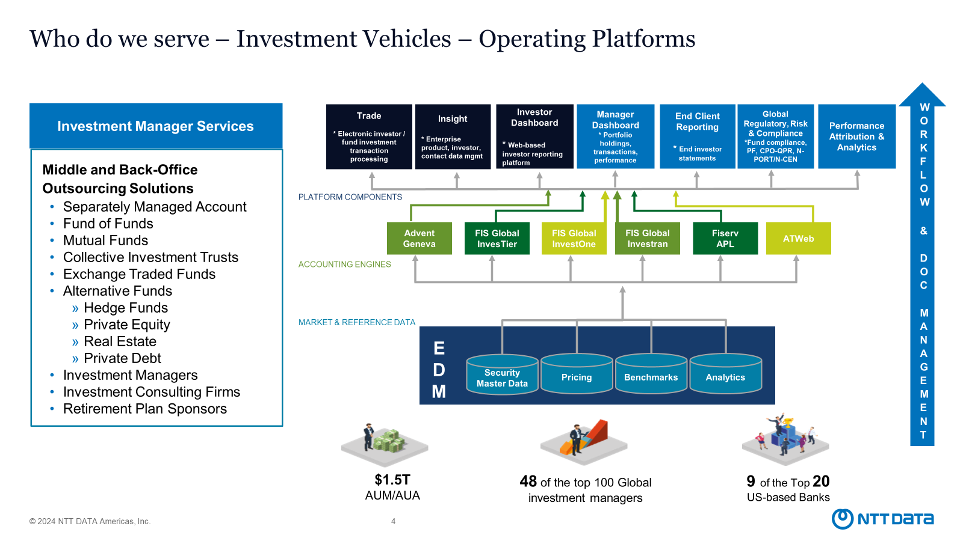
Reference Docs

Slide 9







Proposed Solution – Conceptual View
Cash Recon Tool
Investran
Geneva
Connector Switch
Windows Clients Connector
Core Engine exposed as RESTful API
NTT
Bank Websites
JIRA
Website Connectors
API Connectors
Analysts
Password Manager
AI Powered Reconciliation Engine
Pre-Loader Engine

Slide 10

Proposed Process – Pre-Loader
Automated
Human
Compass Pre Loader
Start
Fetch Credentials:
Bank, Investran from Key Vault
Download Activity, Balances and Transaction Details Reports
Login Investran
Value Proposition
Compass Pre-Loader will perform web crawling, downloading reports from Investran, excel activities, file operations.
The entire process can run end-to-end without human intervention except the one 2FA verification step.
Secured Key Vault will be used to store secured credentials.
Login Bank Website
Store It to Shared Folder
Store It to Shared Folder
Download Transaction & Balance Statements
Combine Bank Statements & Investran reports into one excel file with 5 Sheets, store it in Shared Folder
Push 2FA
Stop
Onshore Analyst
Verify 2FA

Slide 11

Proposed Process – Associate
Automated
Human
Compass Interface
Stop
Start
Post to Geneva?
Create New Issue
Value Proposition
Extended from Compass Framework.
AI Powered reconciliation engine that continuously learn and refine itself using RAG approach.
Works interactively with the analyst and automate steps that are repetitive.
Offshore Analyst
Is Recom. Option Different?
Choose
Excel File
No
Initiate Posting
Yes
For Each Account
Capture Why for self-learning
When All Done
Login JIRA, Chose Specific Account Dashboard
Review Scenario Based Posting Activities Identified
Review Additional Information from Excel file via Tabbed Interface
Make Changes to Activities if needed

